Slide 1
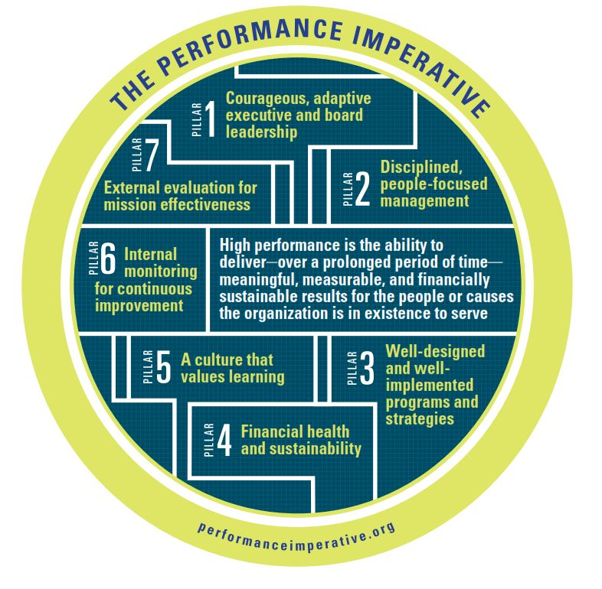
THE
PERFORMANCE
IMPERATIVE
A FRAMEWORK FOR
SOCIAL-SECTOR EXCELLENCE

Slide 2
Shifting from Intentions to Lasting Impact: Understanding the Organizational Journey of Addressing Racial Inequities
Ashley Weaver, Consultant to the Waco Foundation
& Table Discussion Leads

Slide 3
A little about me
Native Wacoan
Black Female
Degrees in Early Childhood Education & Urban Education Policy
Served as the Waco Foundation Director of the SmartBabies Initiative
Currently serve as a consultant with the Waco Foundation
Continually learning to understand the impact of race and racism on myself and the world I live in (aka not an expert)

Slide 4
Session Objectives
To provide resources and allies in the work to begin/continue to shift from good intentions to impactful, equitable outcomes in the local community by:
Providing information regarding the Awake to Woke to Work framework.
Providing a space for authentic dialogue between colleagues regarding the tool and its potential use.
Aid in advancing all participants’ knowledge regarding racial inequities.

Slide 5
Presentation Sources
Equity in the Center
Race Equity Institute

Slide 6
Equity in the Center
Works to shift mindsets, practices, and systems within the social sector to increase racial equity.
Envisions a future where nonprofit and philanthropic organizations advance race equity internally while centering it in their work externally.
Creators of:
Awake to Woke to Work Framework

Slide 7
Race Equity Institute
An alliance of trainers, organizers, and institutional leaders who have devoted ourselves to the work of creating racially equitable organizations and systems. We help individuals and organizations develop tools to challenge patterns of power and grow equity.
Conduct:
2-day Race Equity Institute Workshop
½ day Groundwater Session

Slide 8
INTENTIONS

Slide 9
Name Your Sector Game

Slide 10
Raise your hand if…
You go to work each day to:
Not make a change
Maintain the status quo
Continue to see families remain in poverty
Maintain racial inequities

Slide 11
Raise your hand if…
You go to work each day to:
Not make a change
Maintain the status quo
Continue to see families remain in poverty
Maintain racial inequities
Of course not!

Slide 12
IMPACT

Slide 14
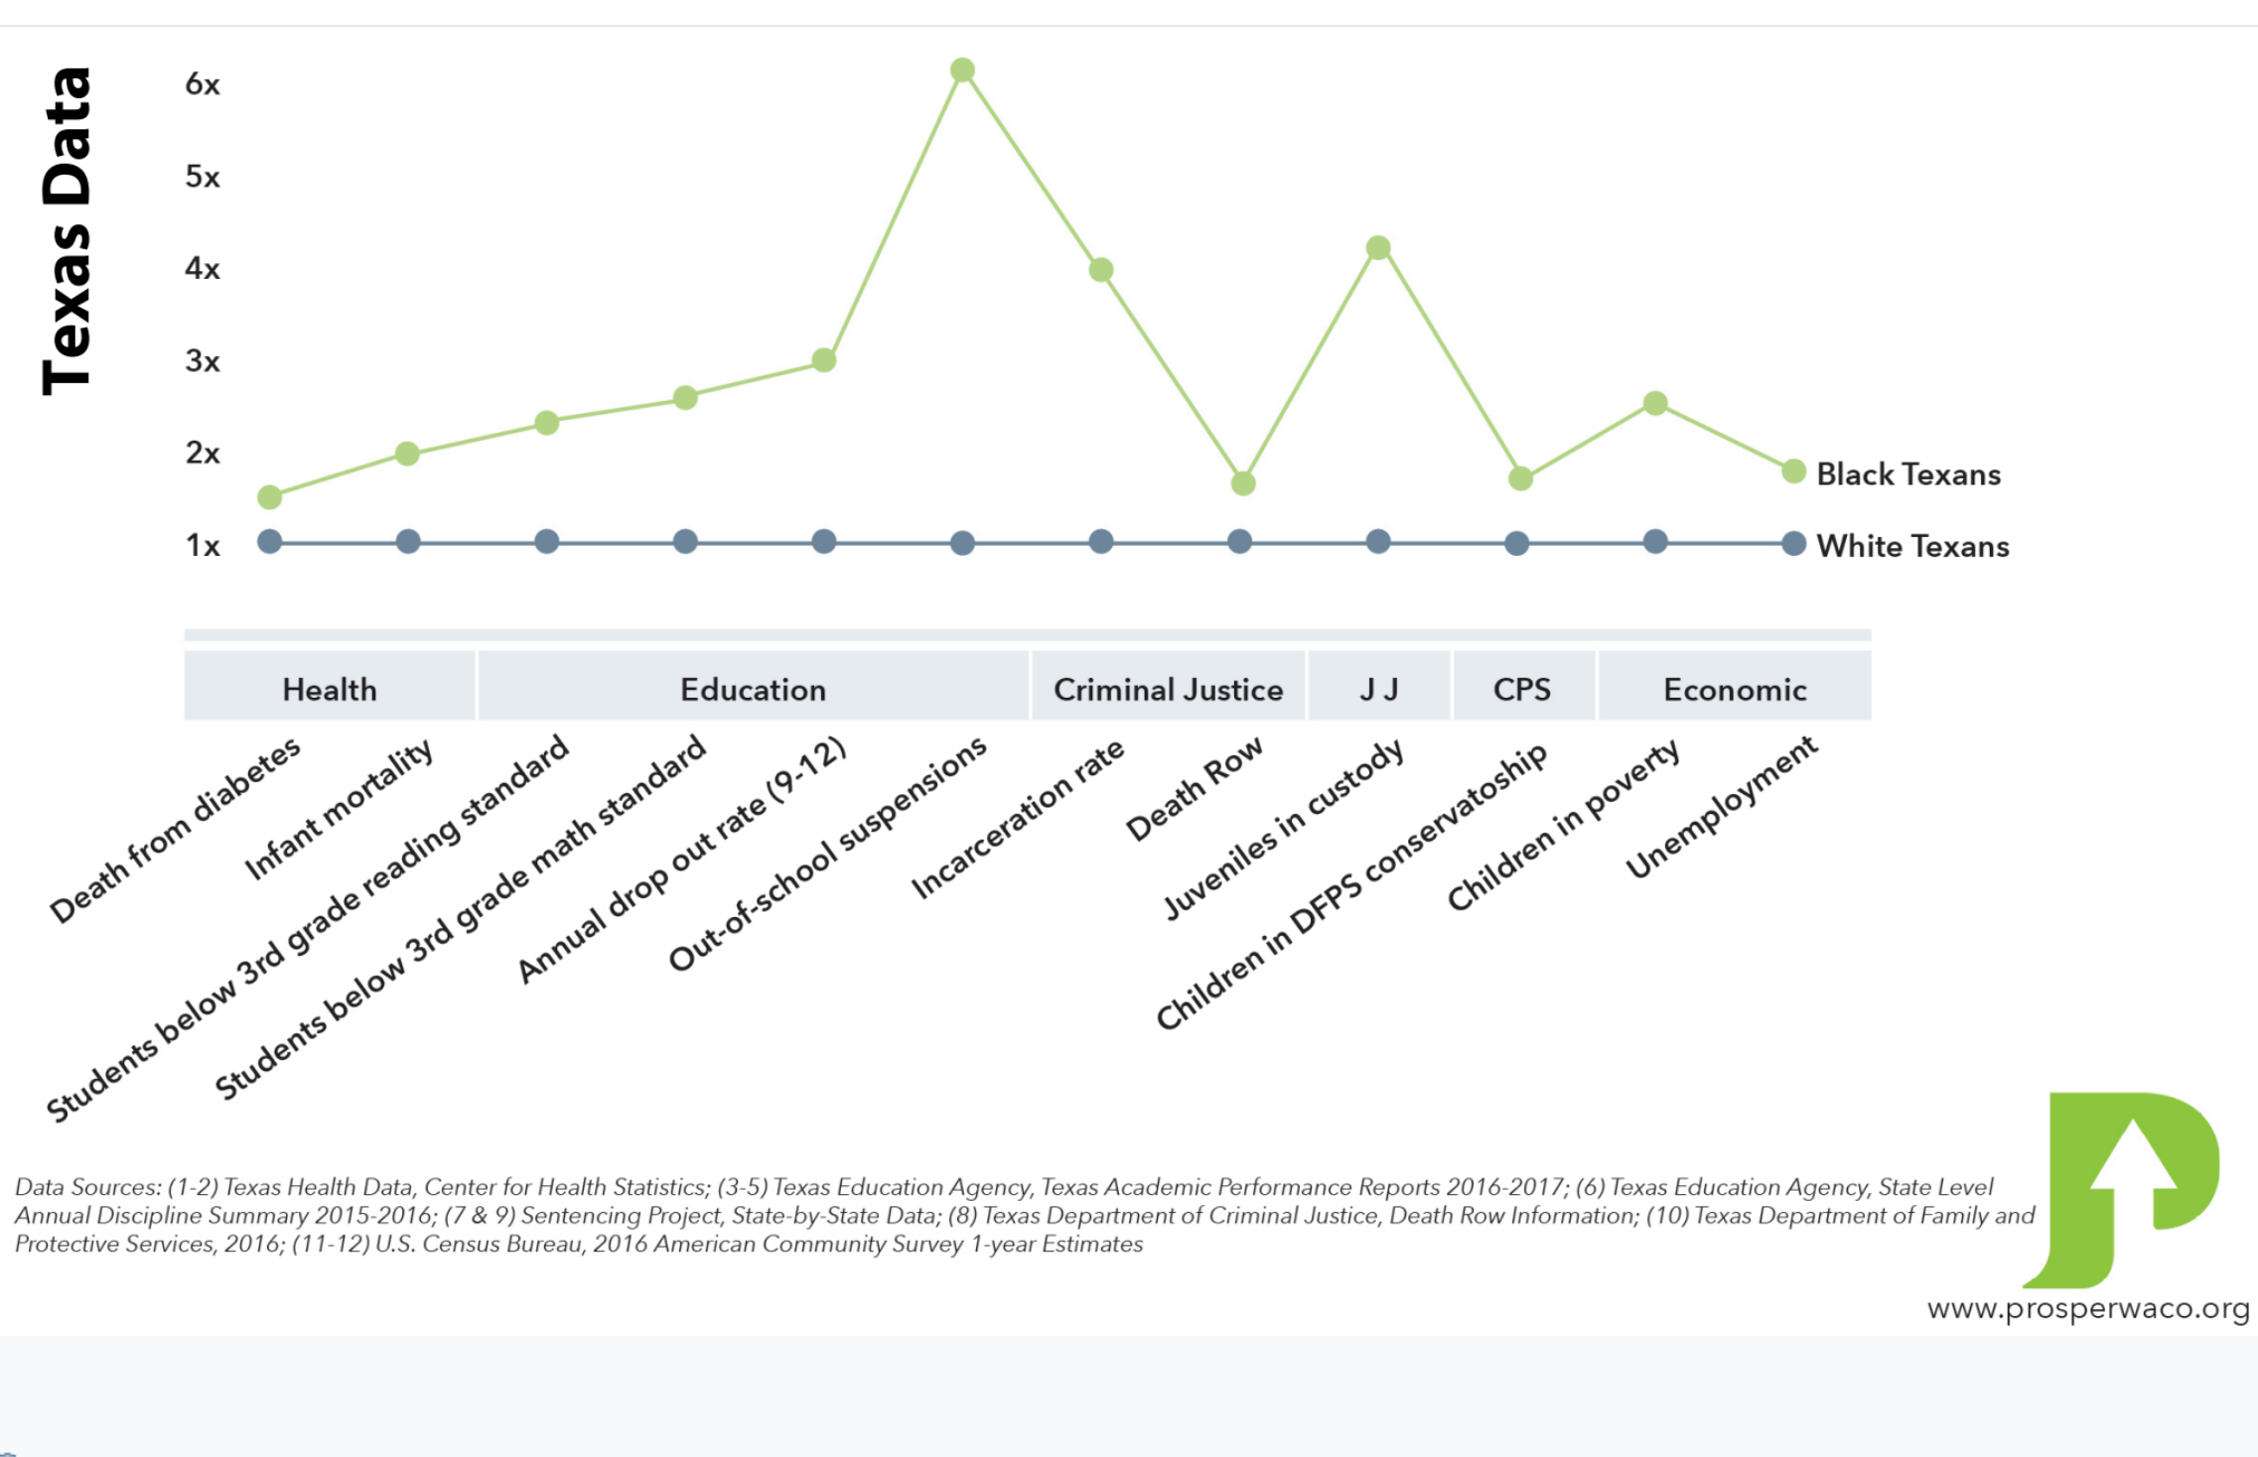

Slide 15
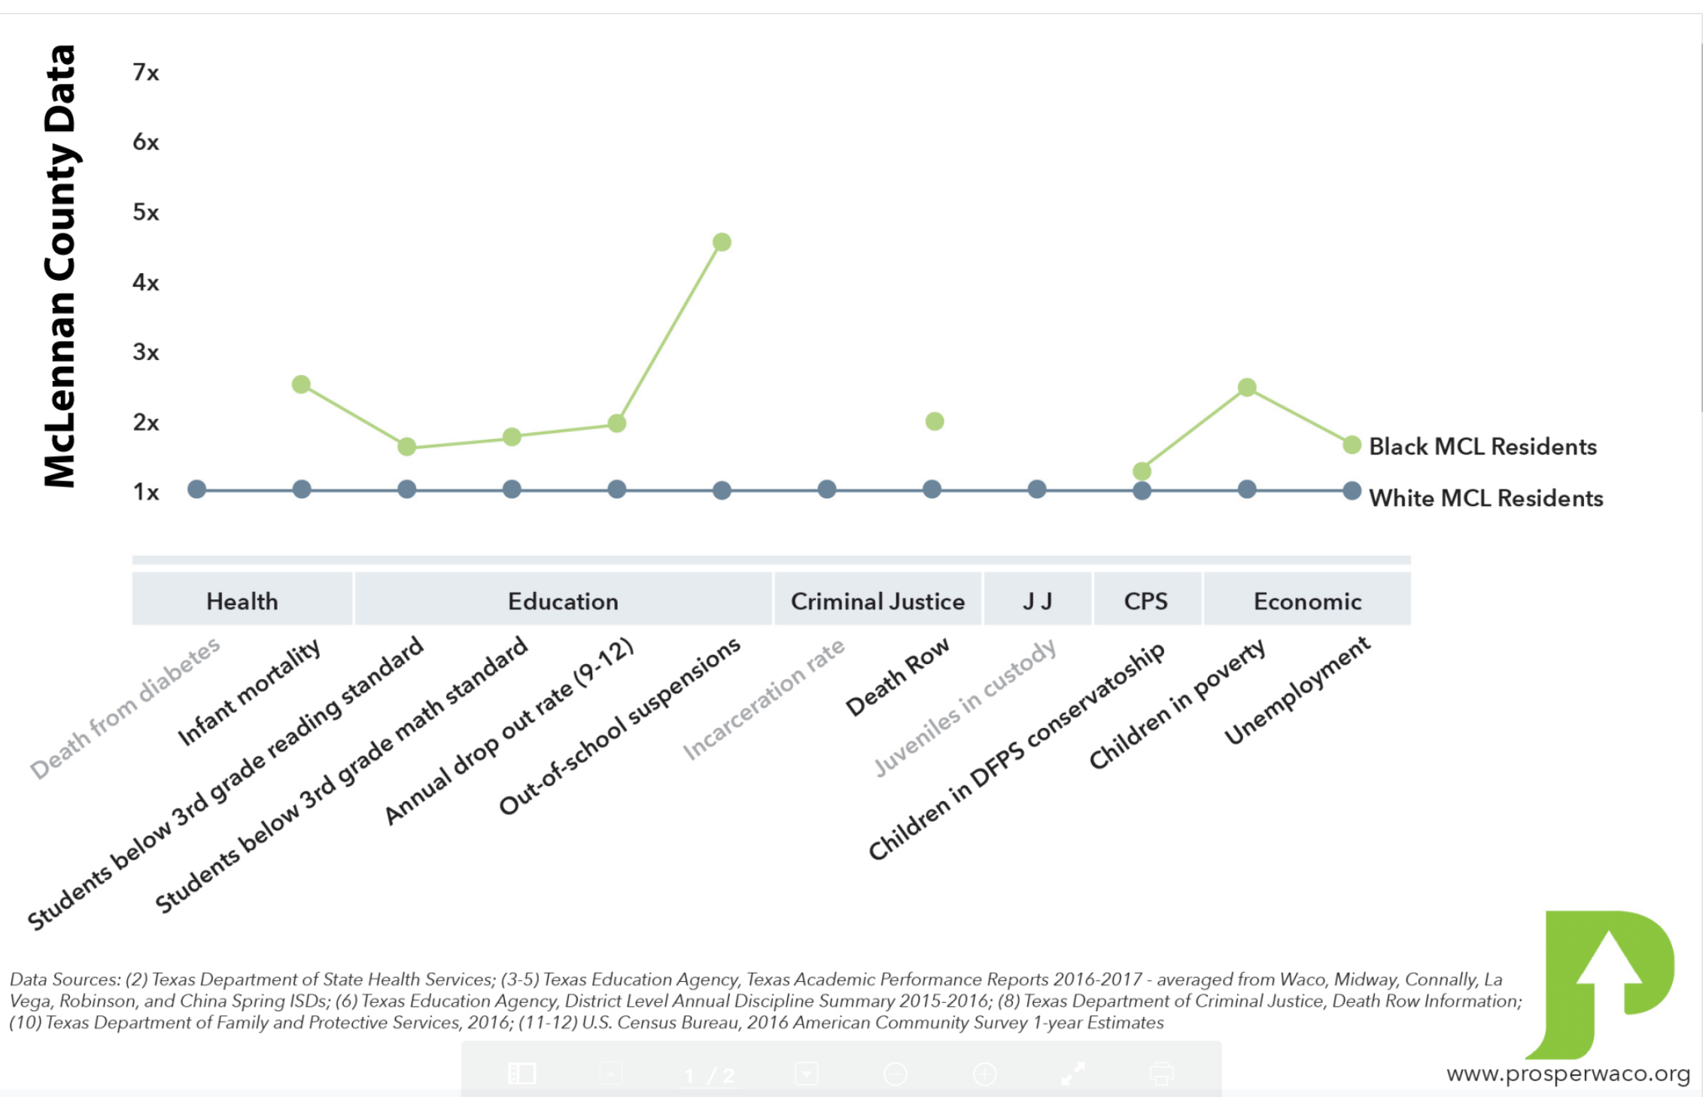

Slide 17
Race Equity Institute helps us to understand…
Racial inequity looks the same across systems
Socio-economic difference does not explain the racial inequity
Systems contribute significantly to disparities
The systems-level disparities cannot be explained by a few ‘bad apple’ or ill-intentioned gatekeepers
Poor outcomes are concentrated in certain geographic communities; usually poor communities and communities of color

Slide 18
Despite our good intentions why do racial inequities remain across systems?

Slide 19
Should we perhaps take some time to reflect as a sector?

Slide 20
How is the mark perhaps being missed?

Slide 21
Equity in the Center helps us to understand….
While issue-specific dynamics play an important role in driving social impact (e.g., public policy around affordable housing or the elimination of food deserts to create access to nutritious foods), the thread of structural racism runs through almost every issue faced by the U.S. social sector. Race equity must be centered as a core goal of social impact across the sector in order to achieve our true potential and fulfill our organizational missions.

Slide 22
As a result….
Cooper Foundation & Waco Foundation have:
Hosted REI workshops since 2016
Their Staff & Board participate in the REI workshop
Allocated resources to continue race equity work
Increased REI workshops and trainings this year
Become a part of the CF Leads Equity 2019-2020 Cohort

Slide 23
What is the ultimate goal?
Achieving race equity — the condition where one’s racial identity has no influence on how one fares in society.
- Equity in the Center

Slide 24
How do we achieve racial equity?
By Building a Race Equity Culture
- Equity In The Center

Slide 25
How do you do that?
Building a Race Equity Culture
is the foundational work when organizations seek to advance race equity.
requires an adaptive and transformational approach that impacts behaviors and mindsets as well as practices, programs, and processes.
The Awake to Woke to Work Framework breaks down the steps for organizations to build a race equity culture.
- Equity In The Center

Slide 26
AWAKE to WOKE to WORK: Building a Race Equity Culture from Equity in the Center
Two parts:
An overview of the resource
Table discussions

Slide 27
The Components of the Awake to Woke to Work Framework

Slide 28
Race Equity Cycle
This journey of change pushes organizations to become more committed, more knowledgeable, and more skilled in analyzing race, racism, and race equity, and in placing these issues at the forefront of organizational and operational strategy.
Because each organization is comprised of different people, systems, and histories, individual organizations will enter the Race Equity Cycle at different stages and will approach their race equity at varying levels.

Slide 29
AWW Components
Levels
Levers
Categories

Slide 30
Levels

Slide 31
Levels
At the AWAKE stage, organizations are focused on people and on building a workforce and boards comprised of individuals from different race backgrounds. The primary goal is representation with efforts aimed at increasing the number of people of different race backgrounds.

Slide 32
Levels
At the WOKE stage, organizations are focused on culture and creating an environment where everyone is comfortable sharing their experiences and everyone is equipped to talk about race equity and inequities. The primary goal is inclusion and internal change in behaviors, policies, and practices.

Slide 33
Levels
At the WORK stage, organizations are focused on systems to improve race equity. The primary goal is integration of a race equity lens into all aspects of an organization. This involves internal and external systems change and regularly administering a race equity assessment to evaluate processes, programs, and operations.

Slide 34
Levers

Slide 35
Levers
SENIOR LEADERS Individuals in a formal leadership role
MANAGERS Individuals who oversee operations of teams
BOARD OF DIRECTORS Governing body of an organization
COMMUNITY Populations served by the organization
LEARNING ENVIRONMENT Investment in staff capacity
DATA Metrics to drive improvements and focus
ORGANIZATIONAL CULTURE Shared values, assumptions, and belief

Slide 36
Categories
Policies & Practices
Data
Personal Beliefs and Behaviors

Slide 37
Categories

Slide 38
There is no singular or ‘right’ way to engage in race equity work. Each organization needs to determine the levers to pull and the actions to take in order to progress in building its own Race Equity Culture.

Slide 39
An example: Waco Foundation’s Journey

Slide 41
Table Discussions

Slide 42
Table Discussions
The REI Alumni were asked to share:
What “hat” they are wearing as table facilitator.
At least one lesson learned from the 2-day Race Equity Institute Workshop.
Where their organization currently is in the framework.
The vision for future work of their organization.
Thoughts about what it takes to get there.
Attendees:
Share the hat you are wearing
Listen attentively
Provide feedback and/or ask questions

Slide 43
Potential questions you may face as you enter this work
How do I create change as the only individual formally engaged in race equity work in my organization?
What tactics can I leverage to build a Race Equity Culture?
How can I speak on my personal experience with racism and internalized racism in my organization?
What is my role in leading this work as a person of color?
What is my role in leading this work as a white person?
What if I make a mistake?
How much does race equity work cost, and how do I operationalize it?
How can I effectively engage senior leadership who may be resistant to directly addressing issues of race and equity?
How do I assess my organization’s state with respect to race equity?
How do I lobby for the support race equity work requires to be effective?
How do measurement, data, and learning play a role in driving organizational change around race equity?

Slide 44
How to get started
1. Establish a shared vocabulary. Ground your organization in shared meaning around race equity, structural racism, and other terms related to this work. The Glossary found in the Appendix is a helpful starting point.
2. Identify race equity champions at the board and senior leadership levels. Select those who can set race equity priorities, communicate them broadly, drive accountability, and influence the speed and depth at which race equity is embedded in the organization.
3. Name race equity work as a strategic imperative for your organization. Define and communicate how race equity connects to your mission, vision, organizational values, and strategies.
4. Open a continuous dialogue about race equity work. Use research and learnings from other organizations to start the conversation with your team or individuals who are invested in your organizational cause.
5. Disaggregate data. Collect, disaggregate, and report relevant data to get a clear picture of inequities and outcomes gaps both internally and externally.

Slide 45
Past REI Alums share where they would like to get started….

Slide 46
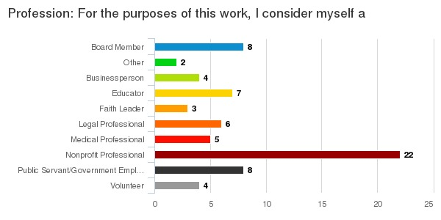

Slide 49
If you want to learn more
- Equity in the Center www.equityinthecenter.org
- YouTube – Webinar: Awake to Woke to Work: Building a Race Equity Culture
- Race Equity Institute www.racialequityinstitute.com
- For more information regarding the local implementation of the Race Equity Institute 2-day Workshop & Groundwater Workshop contact Nicole Wynter @ Nwynter@wacofoundation.org

Slide 50
Thank You!

